Slide 1
Project No.7 ElGemal

Slide 2
INSTRUCTIONS FOR USE
ElGemal
A program that encrypts and then decrypts a string between two entities using the ELGemal algorithm.
Jadx
Analysis of an Android program by means of its reverse engineering
OWASP
Research on OWASP Top 10 2021

Slide 3

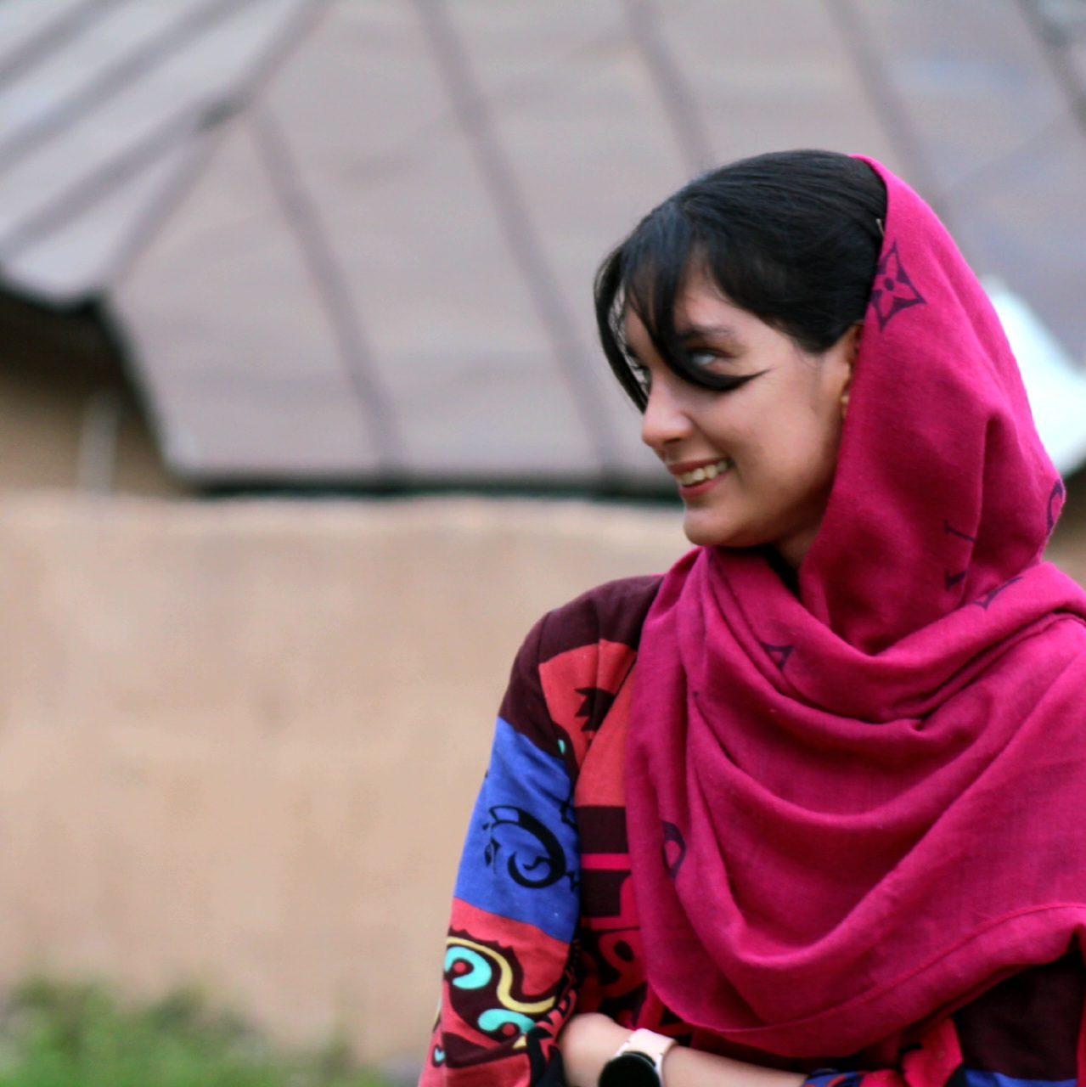
Hoorieh Sabzevari - 98412004
Made by:
Elnaz Rezaee - 98411387

Slide 4
ElGemal
1
Let’s start with the first set of slides

Slide 5
In this section, we have written a program that plays the role of a user.

Slide 6
Steps
Key Generation
Request for Other Party's Public Key
Communication Establishment
Message Encryption
Message Decryption

Slide 7
First part
main function

Slide 8

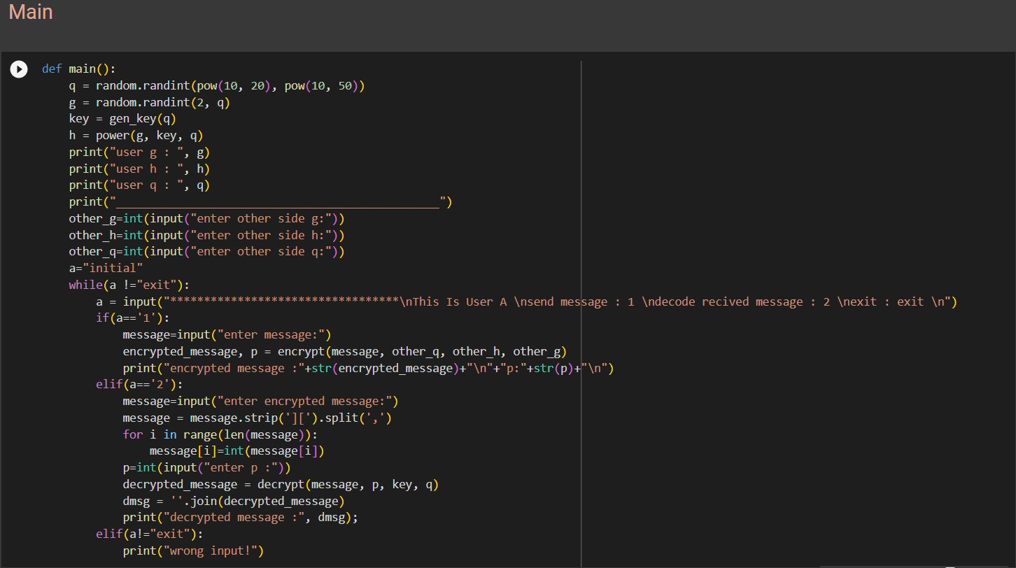
Main function

Slide 9
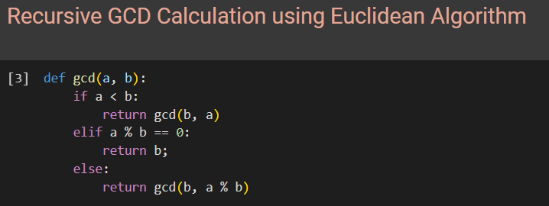
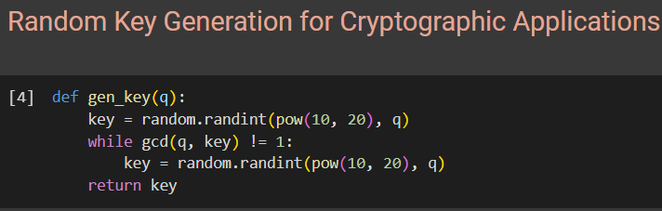
Gcd and gen_key functions

Slide 10
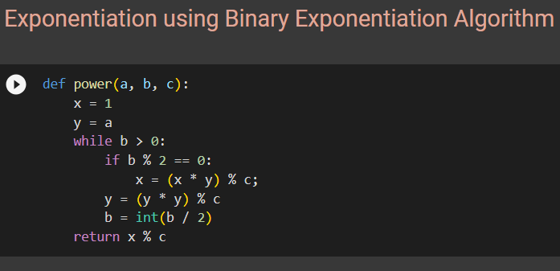
Modular power function

Slide 11
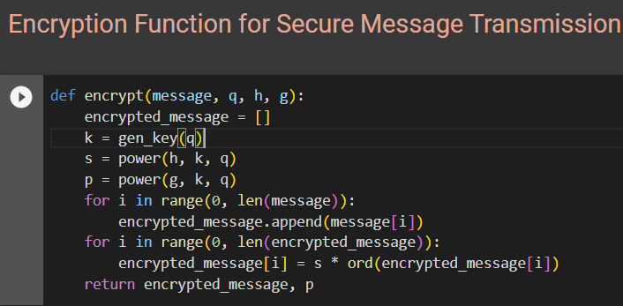
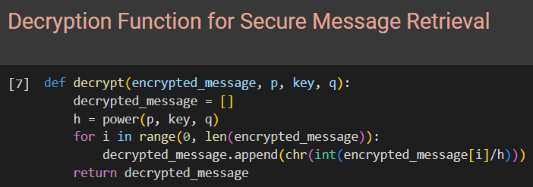
Encrypt and decrypt functions

Slide 12
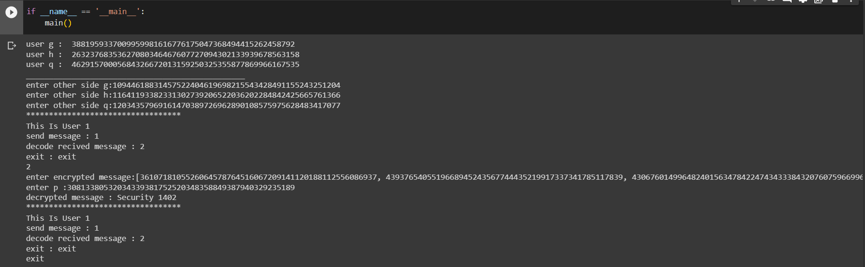
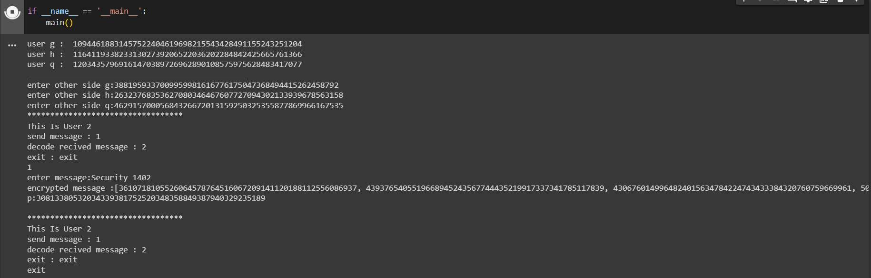
Testing

Slide 13

Jadx
In this part we have to reverse engineer an Android app and report our analysis.

Slide 14

Our chosen program is an Android calculator called PLUS Calculator.

Slide 15
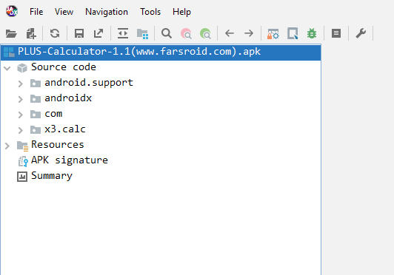
General environment

Slide 16
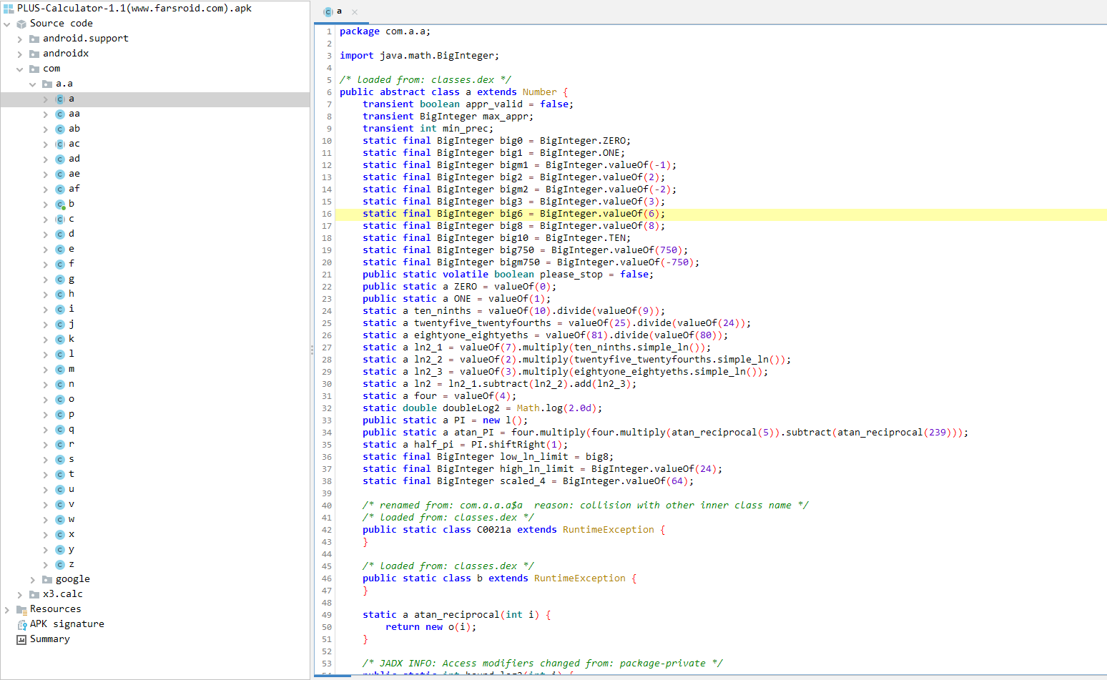
The main code of the program

Slide 17
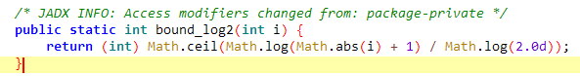
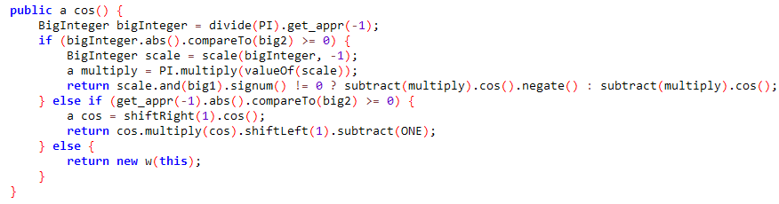
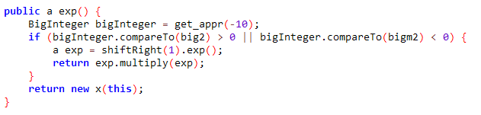
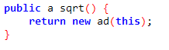
Check the main code of the program

Slide 18
OWASP Top 10 2021
OWASP Top 10 is actually a report compiled by a team of security experts around the world, and its data is an analysis of reports obtained from a number of organizations.

Slide 19
List of vulnerabilities
A01:2021-Broken Access Control
A02:2021-Cryptographic Failures
A03:2021-Injection
A04:2021-Insecure Design
A05:2021-Security Misconfiguration
A06:2021-Vulnerable and Outdated Components
A07:2021-Identification and Authentication Failures
A08:2021-Software and Data Integrity Failures
A09:2021-Security Logging and Monitoring Failures
A10:2021-Server-Side Request Forgery

Slide 20
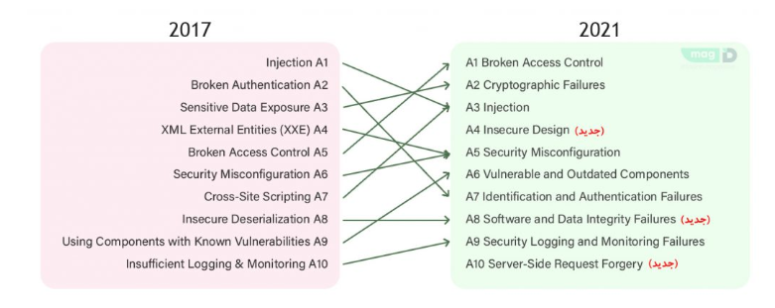
Changes from 2017 to 2021

Slide 21
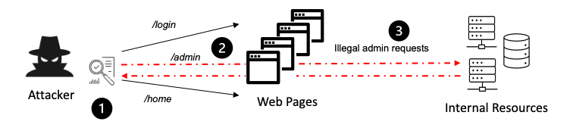
A01:2021-Broken Access Control
This type of risk includes a wide variety of risks, mainly risks that allow attackers to break the restrictions around access.

Slide 22
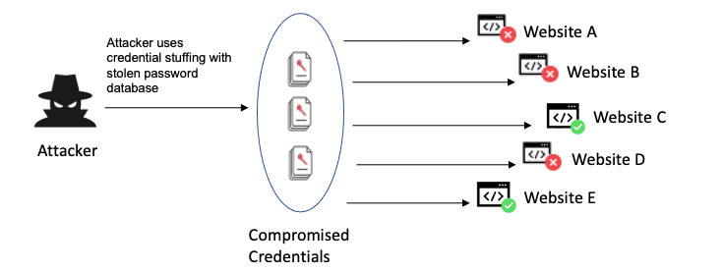
A02:2021-Cryptographic Failures
These types of errors occur when sensitive data and passwords are placed insecurely.

Slide 23
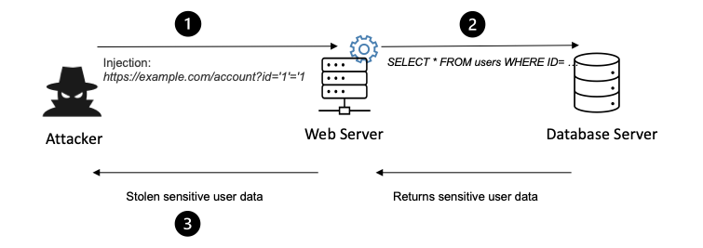
A03:2021-Injection
Risks in this domain include entering unreliable data to an interpreter that is sent as a request or command.

Slide 24
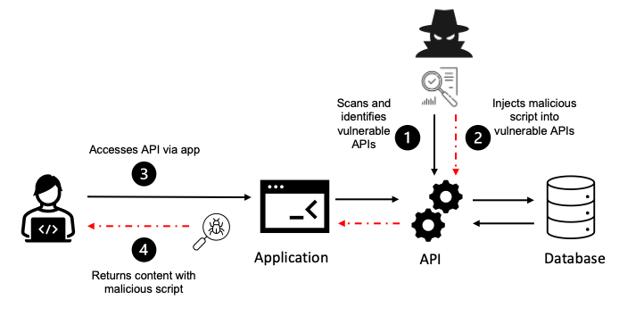
A04:2021-Insecure Design
This is a new issue that involves supporting risks due to "defective control design".

Slide 25
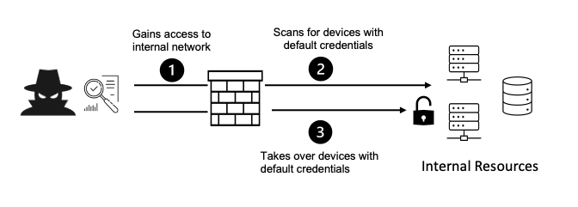
A05:2021-Security Misconfiguration
These types of risks include various types of security risks that include the web environment.

Slide 26
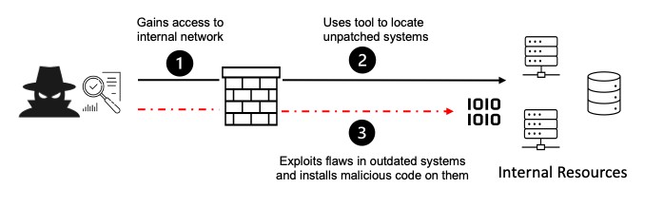
A06:2021-Vulnerable and Outdated Components
Using components and tools that are not patched or updated or have errors in a program causes its security to fail and exposes it to soft attacks.

Slide 27
A07:2021-Identification and Authentication Failures
Verification and authentication as well as session management is a vital action to deal with authentication attacks.

Slide 28
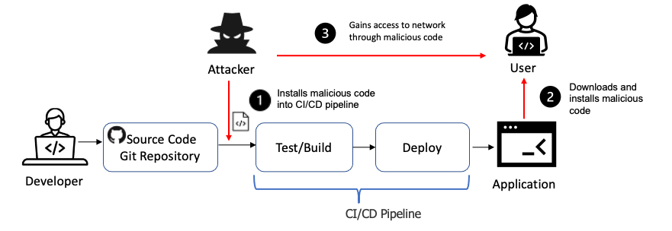
A08:2021-Software and Data Integrity Failures
Attacks and subsets of this category are related to data integrity protection violations in the application code or infrastructure.

Slide 29
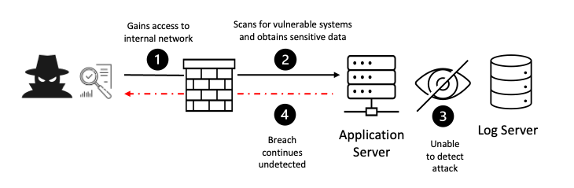
A09:2021-Security Logging and Monitoring Failures
According to the OWASP Top 10 2021, this category is important to help identify, mitigate, and respond to active application defects.

Slide 30
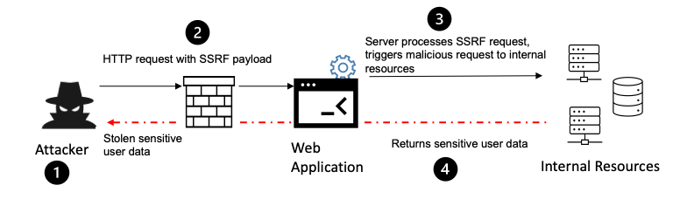
A10:2021-Server-Side Request Forgery
SSRF flaws occur when an application is retrieving data from an external source and there is no validation on the URL provided by the user.

Slide 31
Resources
https://www.irandnn.ir/
https://virgool.io/
https://www.cloudflare.com/
https://owasp.org/
https://github.com/skylot/jadx
https://www.codespeedy.com/
https://my.f5.com/manage/s/article/K44094284

Slide 32
Thanks!
ANY QUESTIONS?
You can find us at:
hoorieh95@gmail.com
elnazrezaee80@gmail.com

